Slide 1
Querying Graph Databases using Natural Text
Presented by:
Nikhil Panda
07/05/2023

Slide 2
Outline
Introduction & background
Project overview
My solution
Experiments & demo
Conclusion & future works

Slide 3
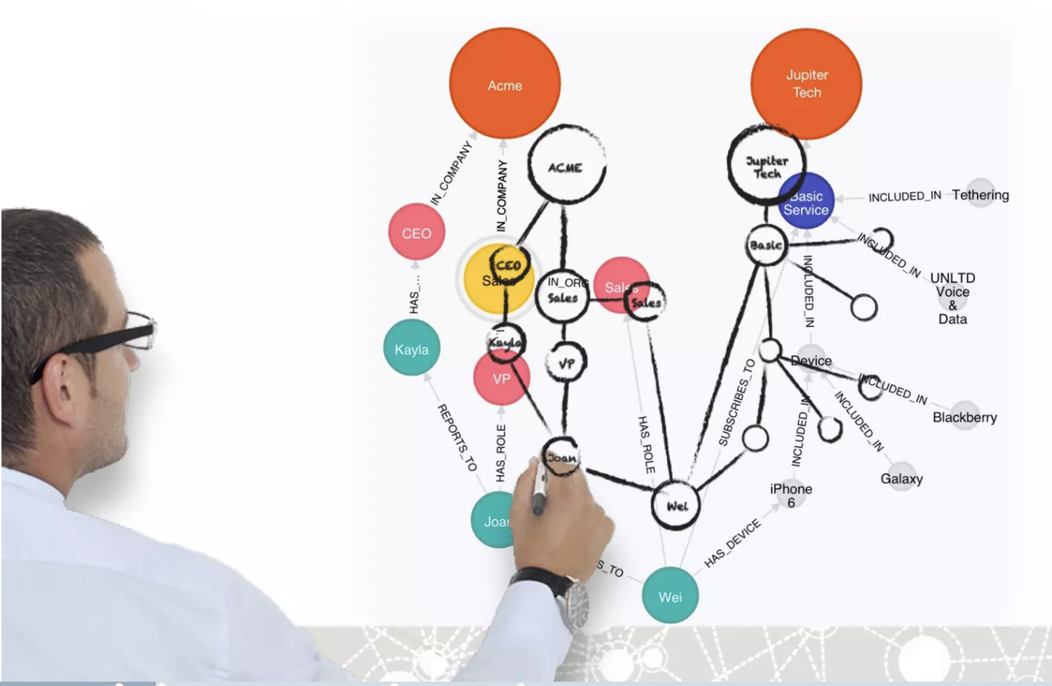
Introduction
Graph databases offer a powerful way to represent and analyze complex relationships in data.
The ability to query graph databases using natural language brings a new level of simplicity, accessibility and enhances user experience and productivity.
This presentation will explore the use of natural text to query graph databases and its benefits.

Slide 4
Graph Databases vs. Traditional Databases
Traditional databases are based on the relational model, which can be limiting for complex relationships.
Store data in nodes and relationships, offering a more intuitive representation of interconnected data. Their flexible structure makes them ideal for scenarios with complex data models.
Graph databases excel at handling complex relationships and traversing paths efficiently.

Slide 5
Graph Databases and Small Infrastructure Capabilities
Scalability: Graph databases offer efficient data storage and processing, ideal for organizations with limited hardware resources. They leverage efficient indexing and data storage techniques to optimize performance.
Cost-Effectiveness: Reduced infrastructure requirements lead to cost savings. This makes them a cost-effective choice for organizations with small infrastructure capabilities.
Suitable for Startups and SMEs: Graph databases allow smaller organizations to harness the power of complex data analysis.

Slide 6
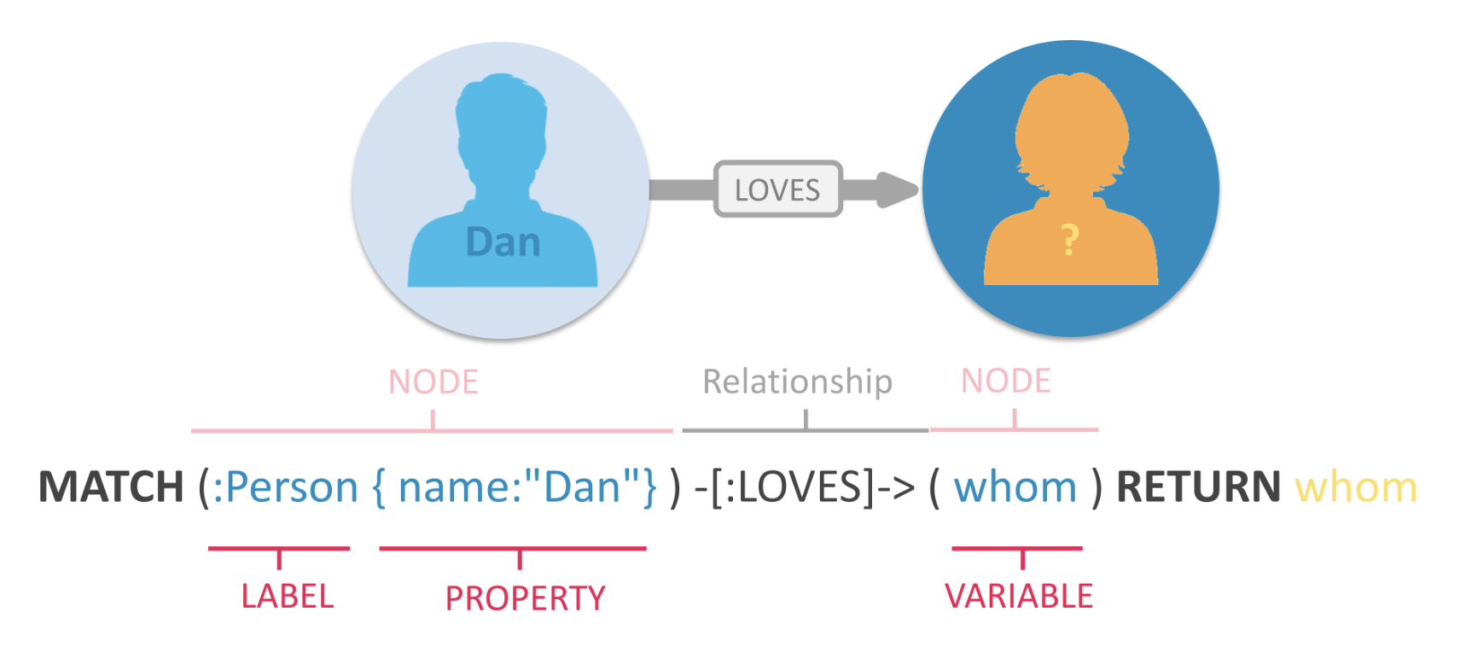
Cypher Queries
Cypher is a query language specifically designed for querying and manipulating data in graph databases. It is widely used in graph database systems like Neo4j.
Drawbacks for Non-Tech users:
Complexity in creating and understanding the Syntax.
Lack of knowledge and higher learning effort needed to get them worked.
Query optimization and advanced querying is not easy.

Slide 7
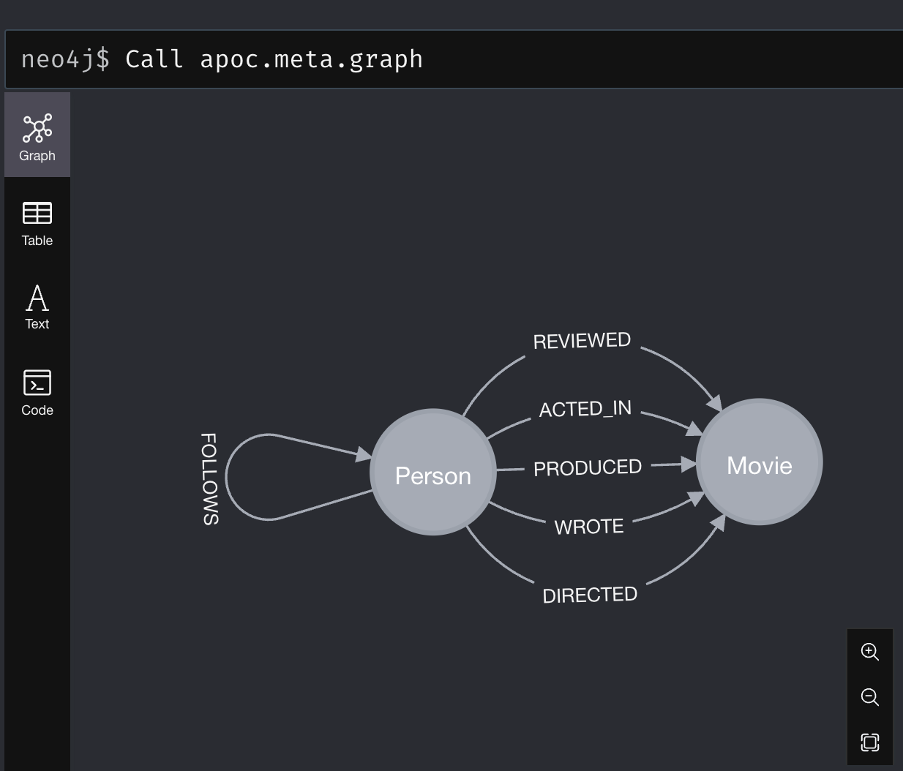
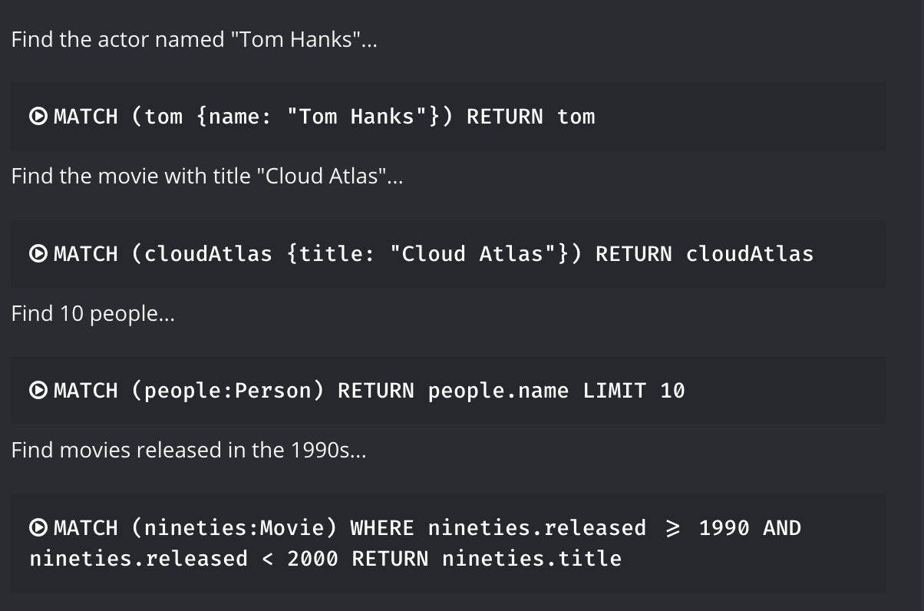
Use Case Overview
Idea: We employ the small NLP trained models to produce the cypher queries that can be executable on the Neo4j databases to retrieve the results.
Our use case revolves around a small movie database stored in a Neo4j database.
Users want to find connections between individuals based on their works and mutual participations.
Using natural language queries, they can easily find relevant information from the graph database.

Slide 8
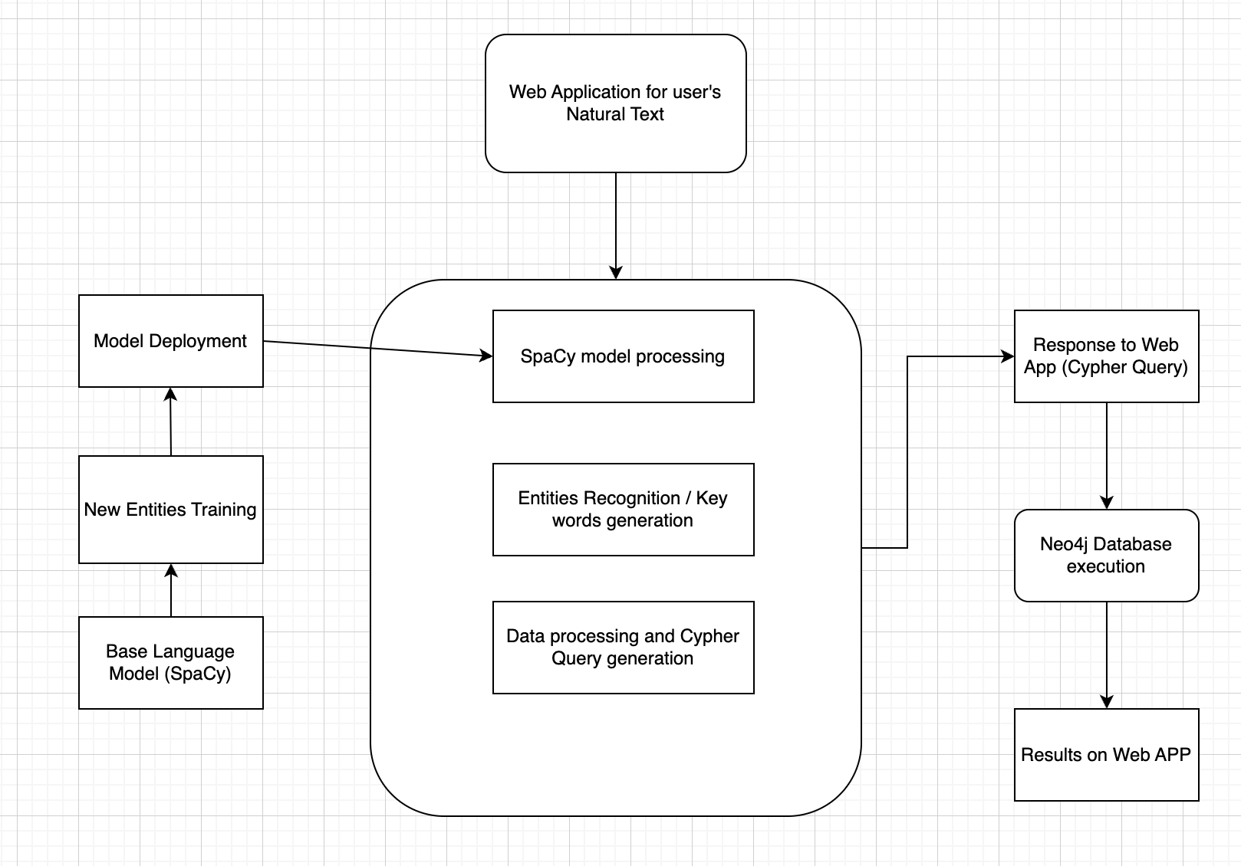
Implementation Process Overview
Web Application: User interface for user to access the graph database.
NLP Model Training: This step involves training any base language model to suit our requirements using new entity names/labels etc..
NLP Model Processing: This step includes natural language processing to find the entities, keywords and query generation from existing query templates.
Neo4j Execution: This step process the query generated for Neo4j cypher execution and then to presenting the results to user.

Slide 9
NLP Model Training
Training the small already developed language models to fulfill our requirements could be effective for our use cases considering the capabilities we are aiming with this project.
Utilizing already developed small language models like SpaCy offers time-saving, reliable performance, extensive language support, flexibility, a rich feature set, and community support compared to developing a new NLP model from scratch for generating Neo4j Cypher queries.
Employed trained models like en_core_web_sm, en_core_web_lg and en_core_web_trf and finalized en_core_web_lg model for my use case based on my computing resources and the available feature set.

Slide 10
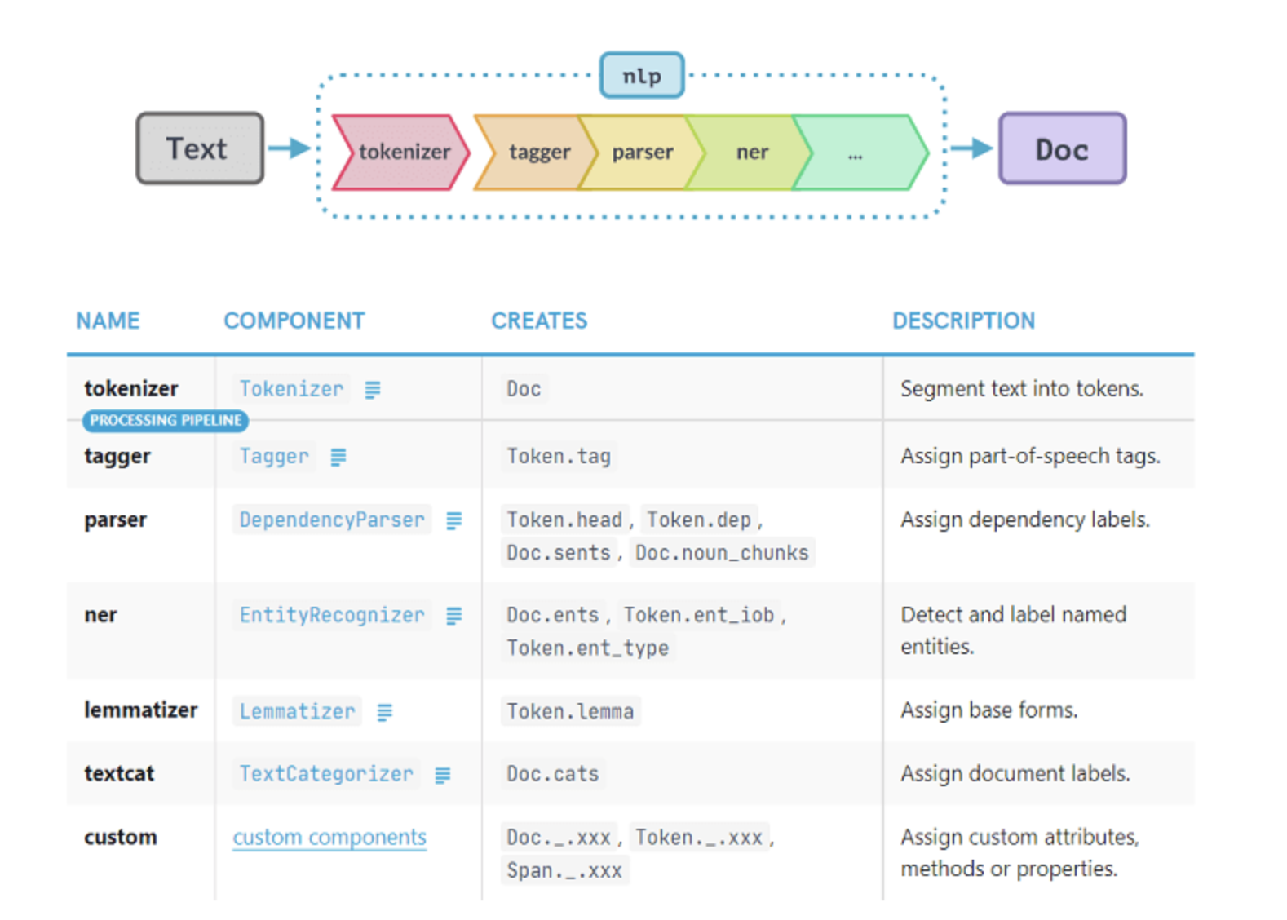
NLP Model Training (Cont…)
Trained the model with few more names for the existing entities WORK_OF_ART and PERSON.
All the movie names have been extracted and trained the base model to identify the entity as ‘WORK_OF_ART’.
All the actor names have been trained as entity ‘PERSON’.
Special keywords and labels has been marked as new entity to ease the process of understanding the natural text and query generation.
Utilizing the Parts of Speech and Dependency between tokens to identify the context for creating new entities for recognizing the node names and relationship names.

Slide 11
Processing from Trained NLP Model:
This process transforms the parsed input into a format that the graph database can understand, such as Cypher queries
Once NLP model is ready, we can consume that model to identify the entities, nodes and relationships the user is interested and then we can process them as template attributes for query templates.
The structured query is generated from the natural language input using a query generation process.
Based on our use case requirements, we can
Create our own rules to convert parsed natural language into Cypher queries.
Customize the attributes and values to narrow the scope of the results or else we can search the keywords on all the attributes.
Example: "Which are John’s Movies?" to "MATCH (p:Person)-[:ACTED_IN]->(m:Movie) RETURN m"

Slide 12
Web Application
By combining a front-end application with Vis.js for graph visualization, you can enhance the user experience, simplify query input, and present the results from Neo4j in an intuitive and interactive manner. This combination empowers users to explore and understand the data more effectively, leading to better insights and decision-making.
A lightweight web application using just Vis.js library provides the user with web pages with less page load time, and rich user experience.
On the contrast of many database accessing tools, this kind of web application will be easy to be deployed in or accessed from end users computing machines with less computing power.
The results can also be presented using various other methods, such as structured data output as API response for more simplified usage as feed to other processes.
Vis.js is a JavaScript library commonly used to create interactive graph visualizations.

Slide 13
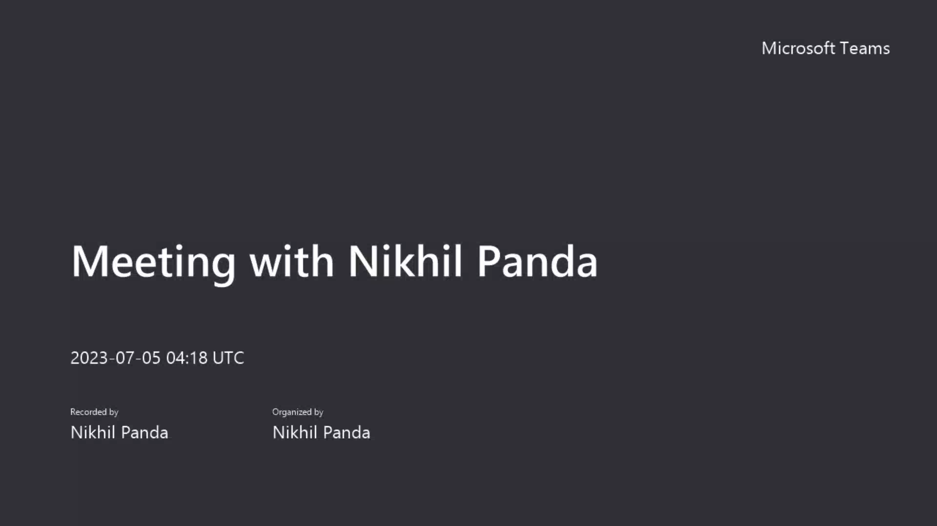
DEMO

Slide 14
Results and Analysis
Although the results are quite promising for easy to moderate level queries. This application requires robust training to handle the complex queries.
While natural text to query graph databases brings numerous benefits, there are also potential limitations and criticisms. Challenges like ambiguity in natural language queries or potential performance issues may arise.
Challenges:
NLP Process:
Limitations like keywords 1990s and co-actors needs to be handled explicitly as NLP model failed in identifying the context accurately.
Web Application:
Interaction within the graph is not fully implemented in Vis.js, would need more libraries or own development to make it more interactive.

Slide 15
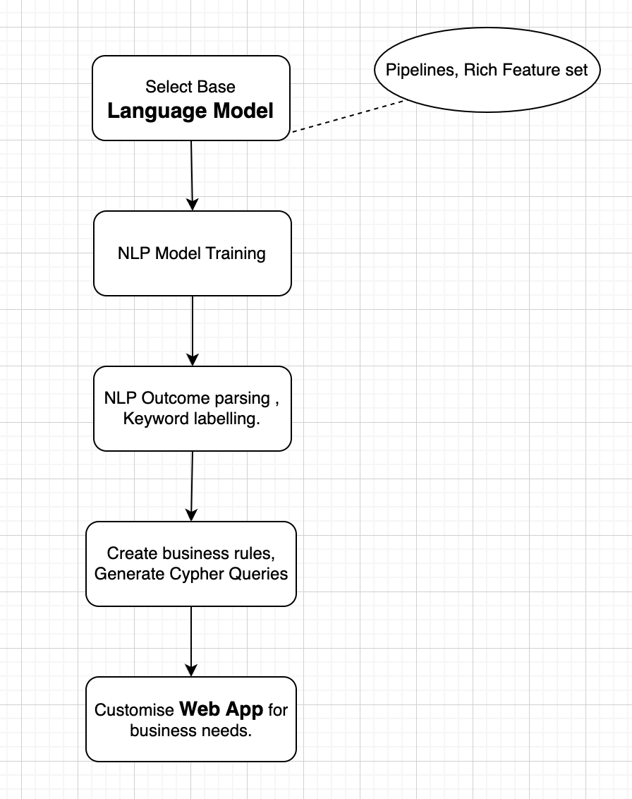
Steps to replicate the process on other databases
Select the base language model based on your requirements like what all the pipelines you needed; entities/labels you need to be recognized.
Train the base model to fulfil desired business requirements.
Parse the NLP information to identify nodes and relations.
Create own rules and generate cypher queries from derived NLP information.
Customize the Web Application for better user experience with rich business cases.

Slide 16
Real-World Examples
Health Care Analysis: The project can assist in analyzing healthcare data, such as patient records and medical research. Natural language queries like "Find patients with a specific condition and their related treatments" can be transformed into Cypher queries to retrieve relevant data from the graph database and visualize medical relationships.
Knowledge Graph Exploration: The project can enable users to explore and navigate large knowledge graphs. Users can input natural language queries like "What are the connections between topic A and topic B?" to explore the relationships and connections within the graph database and visualize the results in the web application. This one is similar to the use case we are having in FedEx.

Slide 17
Future Works
Improve the NLP training for robust natural text processing to process complex queries.
Implementing attribute mappings for clumsy attribute names would help narrow down the results.
Training the NLP model on Cypher queries dataset may ease the NLP process and dependency.
Offer autocomplete or suggestion features to assist users in constructing queries in the web application.
Also, user feedback enhance the user experience

Slide 18
Conclusion
This project demonstrates the power and potential of using natural text to query graph databases, empowers users to efficiently access and analyze complex data.
It combines the strengths of graph databases and natural language processing to enhance productivity and user experience. We enable non-technical users to interact with complex data structures effortlessly
The ability to visualize query results in a user-friendly interface empowers users to gain valuable insights and discover meaningful relationships within the data.
While there may be challenges in query construction and optimization, this project showcases the accessibility and practicality of leveraging natural language and graph databases for various real-world applications.

Slide 19
References
Natural Language Processing (NLP) for Business Use-Cases
The Graph Database Advantage for Enterprise Architects
A Natural Language Interface for Querying Graph Databases
Cypher Query Language
NLDS-QL: From natural language data science questions to queries on graphs: analysing patients conditions & treatments
Natural Language to SQL from Scratch with Tensorflow
Accelerating Towards Natural Language Search with Graphs

